Slide 1
Introduction to Formal Grammar

Slide 2
What is Grammar?
Definition: The grammar of a language defines its alphabet and lexicon.
Syntax: Specifies valid sequences of symbols forming phrases and sentences.
Production Rules: A grammar consists of rules to transform strings.

Slide 3
Grammar of a Language
The grammar of a language defines its alphabet and lexicon. Through syntax, it specifies the valid sequences of symbols that form well-formed phrases and sentences.
A grammar consists of a set of production rules for transforming strings.
To generate a string in the language, you start with a string consisting of a single start symbol.

Slide 4
Grammar of a Language
Production rules are then applied, in any order, until the string contains neither the start symbol nor any designated nonterminal symbols.
The language formed by the grammar consists of all the distinct strings that can be generated this way.

Slide 5
Grammar of a Language
A particular sequence of production rules applied to the start symbol results in a unique string in the language.
If there are multiple ways to generate the same string, the grammar is considered ambiguous.

Slide 6
A grammar
A grammar is often viewed as a language generator.
However, it can also serve as the basis for a "recognizer“. A function in computing that determines whether a given string belongs to the language or is grammatically incorrect.
To describe such “recognizers”, formal language theory utilizes automata theory.
An important result of automata theory is that it is impossible to design a recognizer for certain formal languages.

Slide 7
String Generation Process
Start with a single start symbol.
Apply production rules until the string contains no start or nonterminal symbols.
Language: Composed of all distinct strings generated.
If multiple ways to generate the same string → Ambiguity.

Slide 8
Grammar as Generator and Recognizer
Generator: Produces strings in the language.
Recognizer: Checks if a string belongs to the language.
Automata Theory: Describes recognizers, showing that some languages cannot have a recognizer.

Slide 9
The Syntax of Grammars
In the classic formalization of generative grammar, a grammar G consists of the following components:
A finite set N of non-terminal symbols, none of which appear in strings formed by G.
A finite set Σ (Sigma) of terminal symbols, disjoint from N.

Slide 10
The Syntax of Grammars
A finite set P of production rules, each of the form X→YX \rightarrow YX→Y, where X is a string of symbols (the "head"), and Y is another string of symbols (the "body").
If the body is empty (i.e., the rule represents an empty string), it may be denoted using special symbols such as ϵ (epsilon) or ‘_’.
A distinguished start symbol S.

Slide 11
The Syntax of Grammars
Thus, a grammar is formally defined as the tuple G = (N,Σ,S,P)
where:
N is the set of non-terminal symbols.
Σ (Sigma) is the set of terminal symbols (the alphabet).
S is the start symbol.
P is the set of production rules.

Slide 12
Terminals (T)
These are the basic symbols or tokens that cannot be broken down further.
In natural language, terminals are words or punctuation marks.
In programming languages, terminals are keywords, operators, or identifiers.
Example: In the sentence "The cat sleeps," the terminals are "The," "cat," and "sleeps."

Slide 13
Non-terminals (N)
These are variables that represent groups of symbols or patterns.
Non-terminals are defined using production rules.

Slide 14
Production Rules (P)
These are rules that define how sequences of terminals and non-terminals can replace non-terminals.
Each rule has a left-hand side (a non-terminal) and a right-hand side (a sequence of terminals and/or non-terminals).
Example: <sentence> → <subject> <verb> <object>.

Slide 15
Start Symbol (S)
This is a special non-terminal that represents the initial symbol from which all valid strings in the language are derived.
Example: In a grammar for sentences, the start symbol might be <sentence>

Slide 16
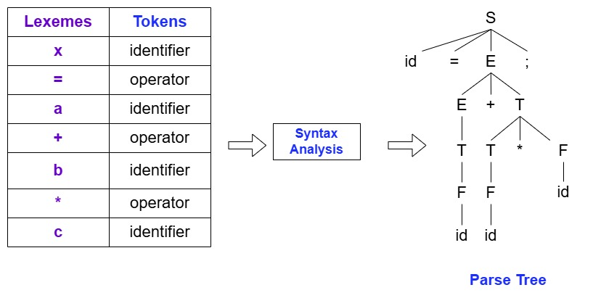

Slide 17
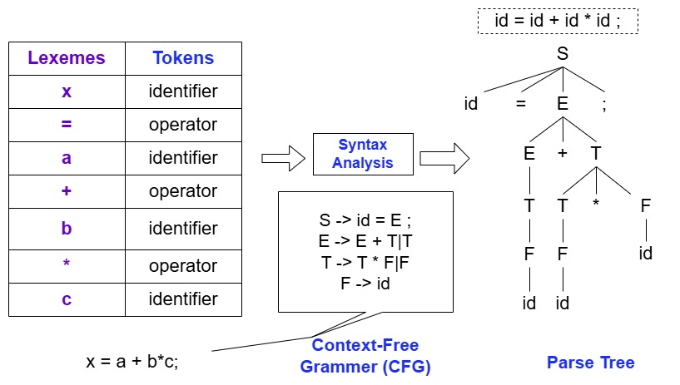

Slide 18
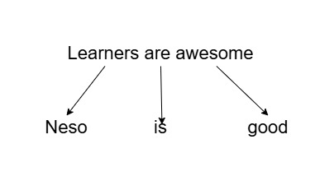

Slide 19
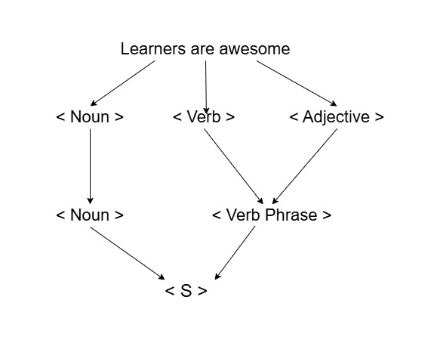

Slide 20
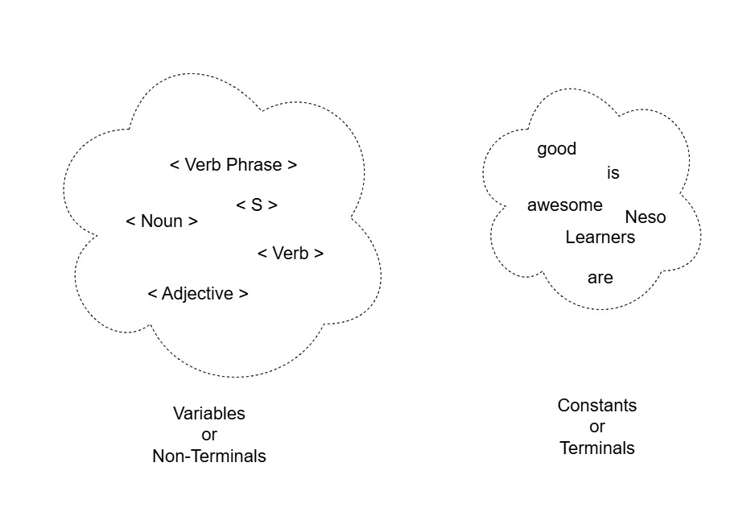

Slide 21
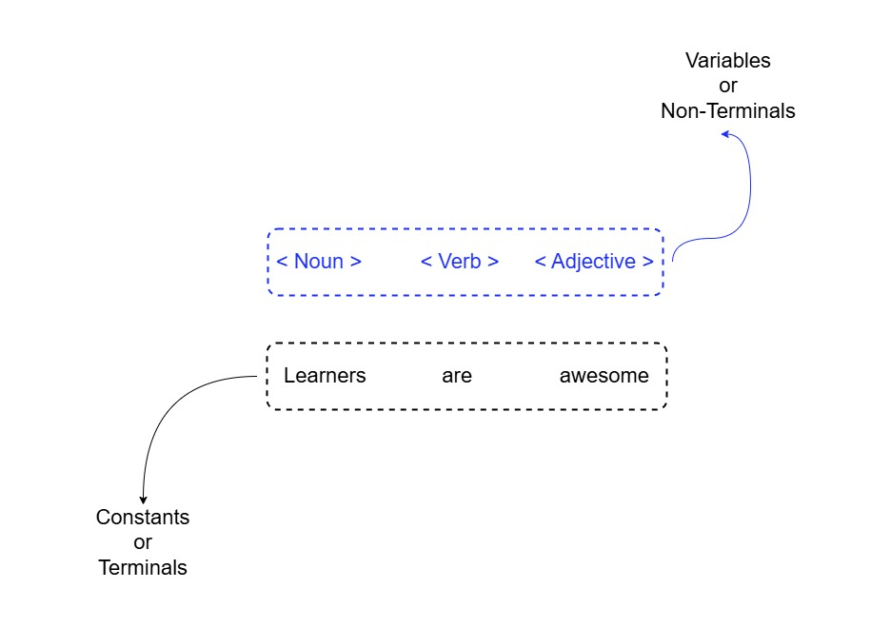

Slide 22
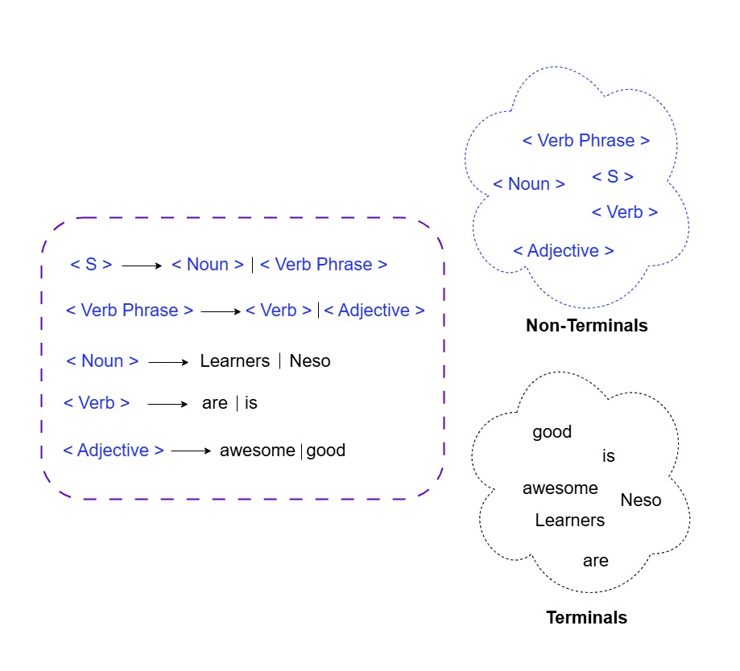

Slide 23
Example
For example, consider the following grammar:
N = {S,A} (where S is the start symbol),
Σ = {a,b} (alphabet),
P includes the rules:
S → aSb
S → ba

Slide 24
Example: Generating Strings
Using the above grammar, we can generate strings starting from S:
Start with S.
Apply rule 1: S → aSb.
Apply rule 1 again: S → aSb resulting in aaSbb.
Apply rule 2: S → ba resulting in aababb.
We can write this series of choices more briefly, using symbols: S → aSb → aaSbb → aababb
The language of the grammar is then the infinite set {a^{n} bab^{n} | n ≥ 0} = {ba, abab, aababb, aaababbb, }

Slide 25
The grammar generates strings where:
The number of a's before the central ba equals the number of b's after it.
The central ba is fixed, acting as a "divider."
Examples:
0 ba - No a's or b's added.
1 abab - One a left, one b right.
2 aababb - Two a's left, two b's right.
3 aaababbb - Three a's left, three b's right.

Slide 26
The grammar generation
The number of a's before the central ba equals the number of b's after it.
The central ba is fixed, acting as a "divider."
nn | String | Explanation
0 | ba | No a's or b's added.
1 | abab | One a left, one b right.
2 | aababb | Two a's left, two b's right.
3 | aaababbb | Three a's left, three b's right.

